Slide 1
Mathematical Preliminaries
Introduction to Deep Learning
Module 1, Class 4

Slide 2
Pre-read
Matrix Calculus, Sections 2.1.1, 2.1.2. Do some of the exercises (1.4)
Essence of Linear Algebra (YouTube series by 3Blue1Brown)
Good intuition on how matrices encode linear transformation of vectors.
Khan Academy Videos
Matrix product examples
Matrix product associativity
Distributive property of matrix products
Watch the entire linear algebra series, if you have time.. It covers the concepts of linear transformations quite well
Using python, generate two matrices A (n=4,m=5) and B(m=5, k=3) with random numbers and calculate their product, C=AB using nested for loops
Now consider square matrices (n=m=k). Verify that AB is not equal to BA. When would AB = BA?

Slide 3
Agenda
Introduction to multi-valued functions of many variables
Numerator and Denominator notation
Extension of chain rule to multivariate functions
Derivatives of matrix operations
Solving linear regression using matrix math
Derivation of backpropagation

Slide 4
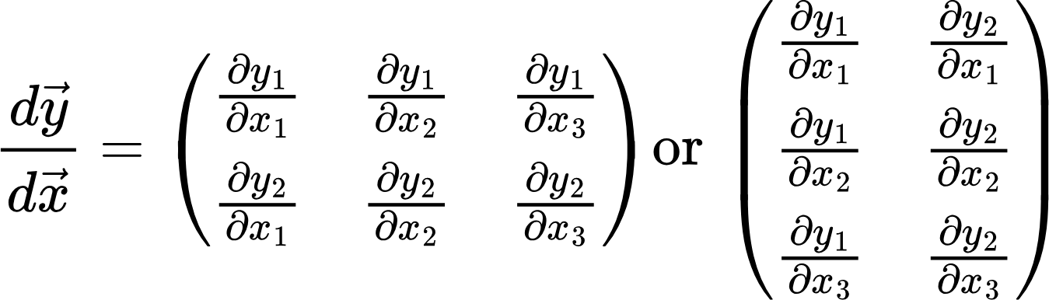
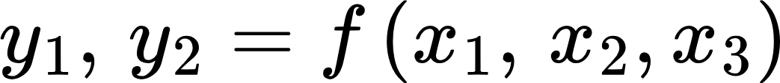
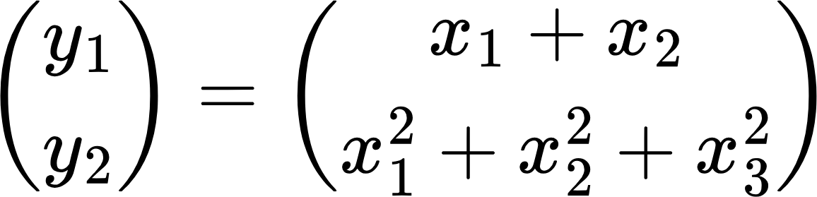
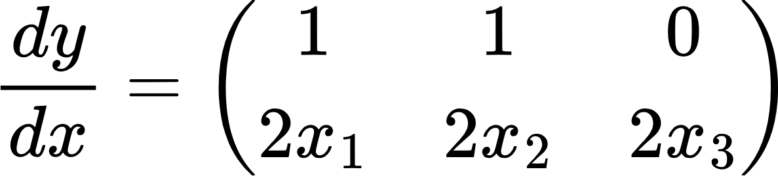
Derivative of multivariate functions
Up until now, the output of a function was a scalar.. But it can also be multivariate..
Denominator Notation
y
x
Numerator Notation
Example:

Slide 5
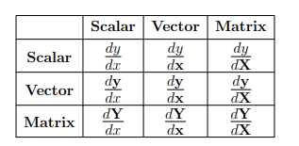
Derivative of multivariate functions
Derivative of scalar wrt vector (n, 1). Output: vector (n, 1)
Derivative of scalar wrt matrix (n, m). Output: matrix (n, m)
Derivative of scalar wrt scalar
Derivative of vector (n,1) wrt scalar. Output: vector (n,1)
Derivative of vector wrt matrix. Output: Tensor
Derivative of vector (n,1) wrt vector (m,1). Output: matrix (m,n)
Derivative of matrix wrt matrix. Output: Tensor
Derivative of matrix (n,m) wrt scalar (1,1). Output: matrix (n,m)
Derivative of matrix wrt vector. Output: Tensor
We’ll use Denominator Notation throughout!

Slide 6
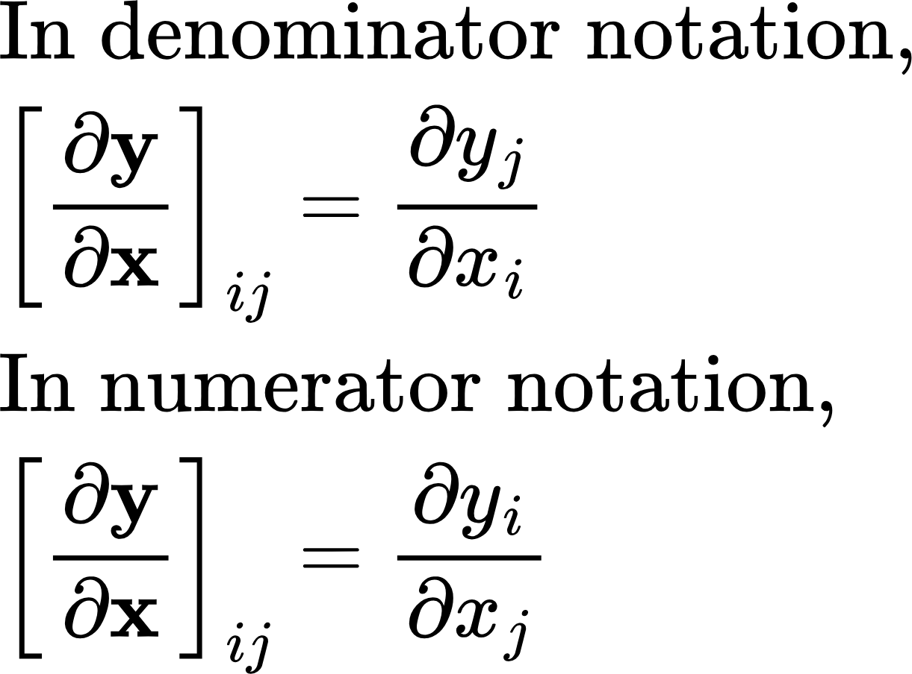
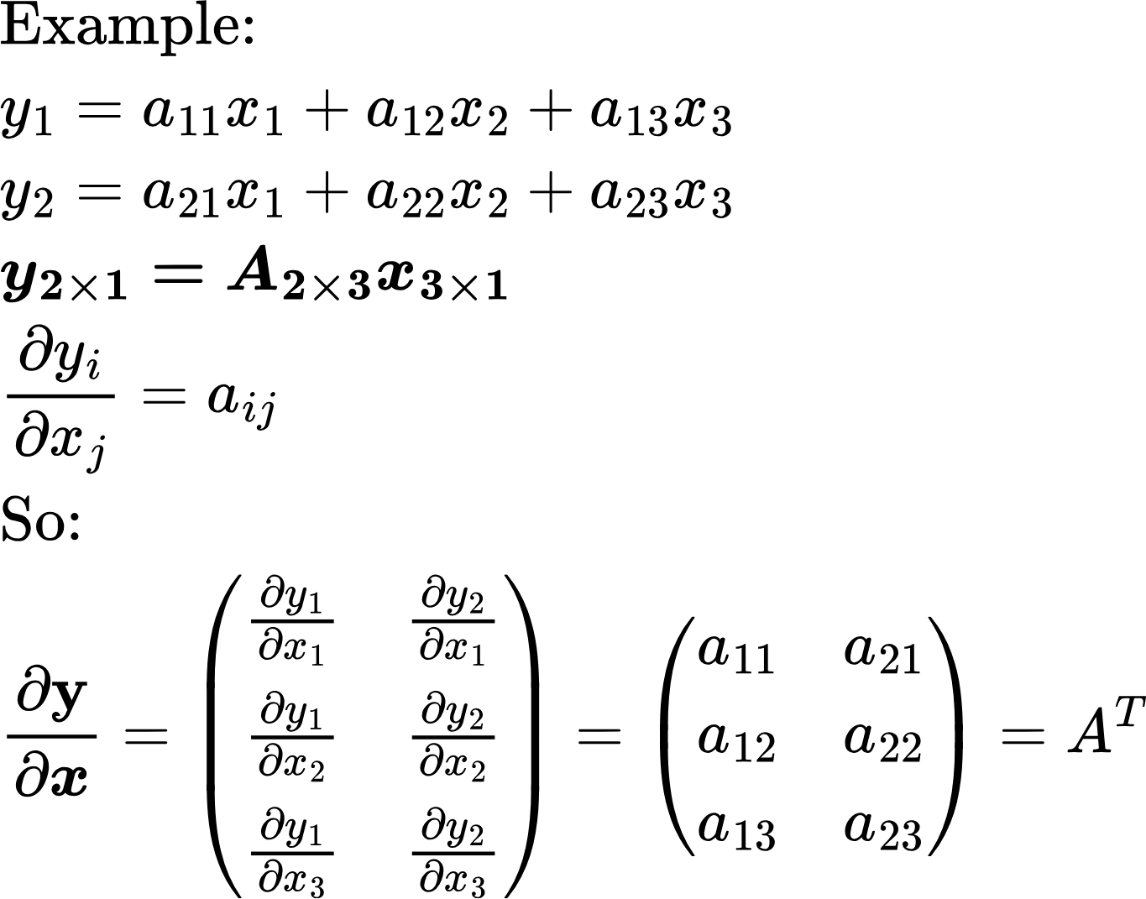
Derivative of multivariate functions

Slide 7
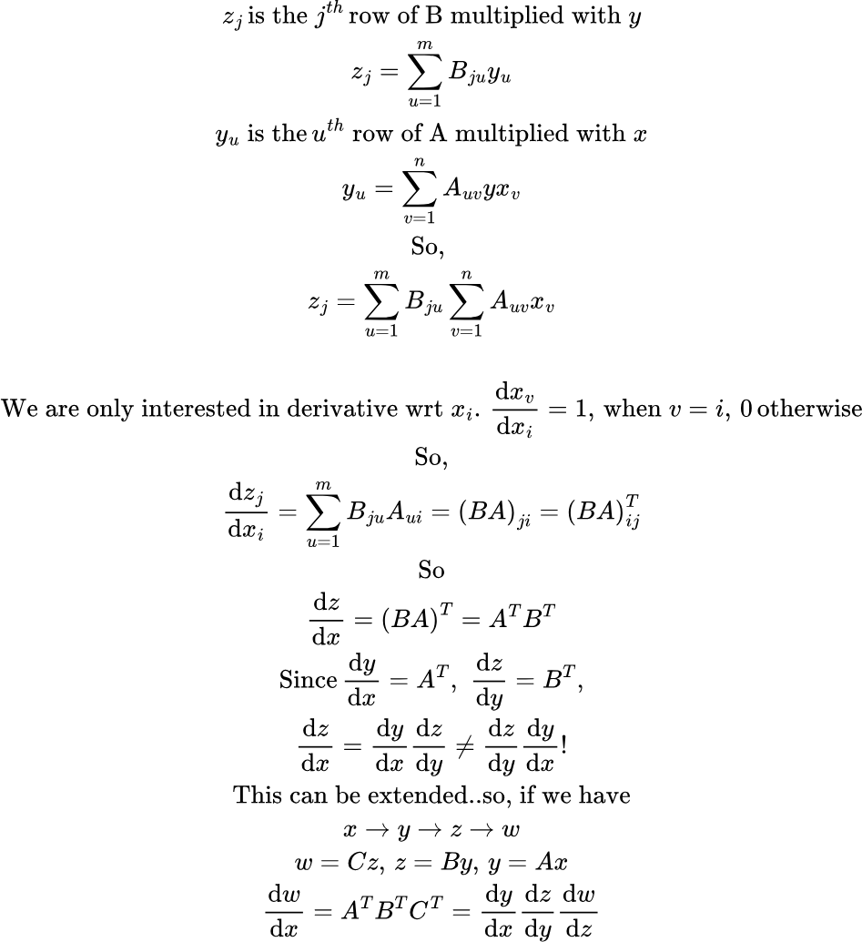
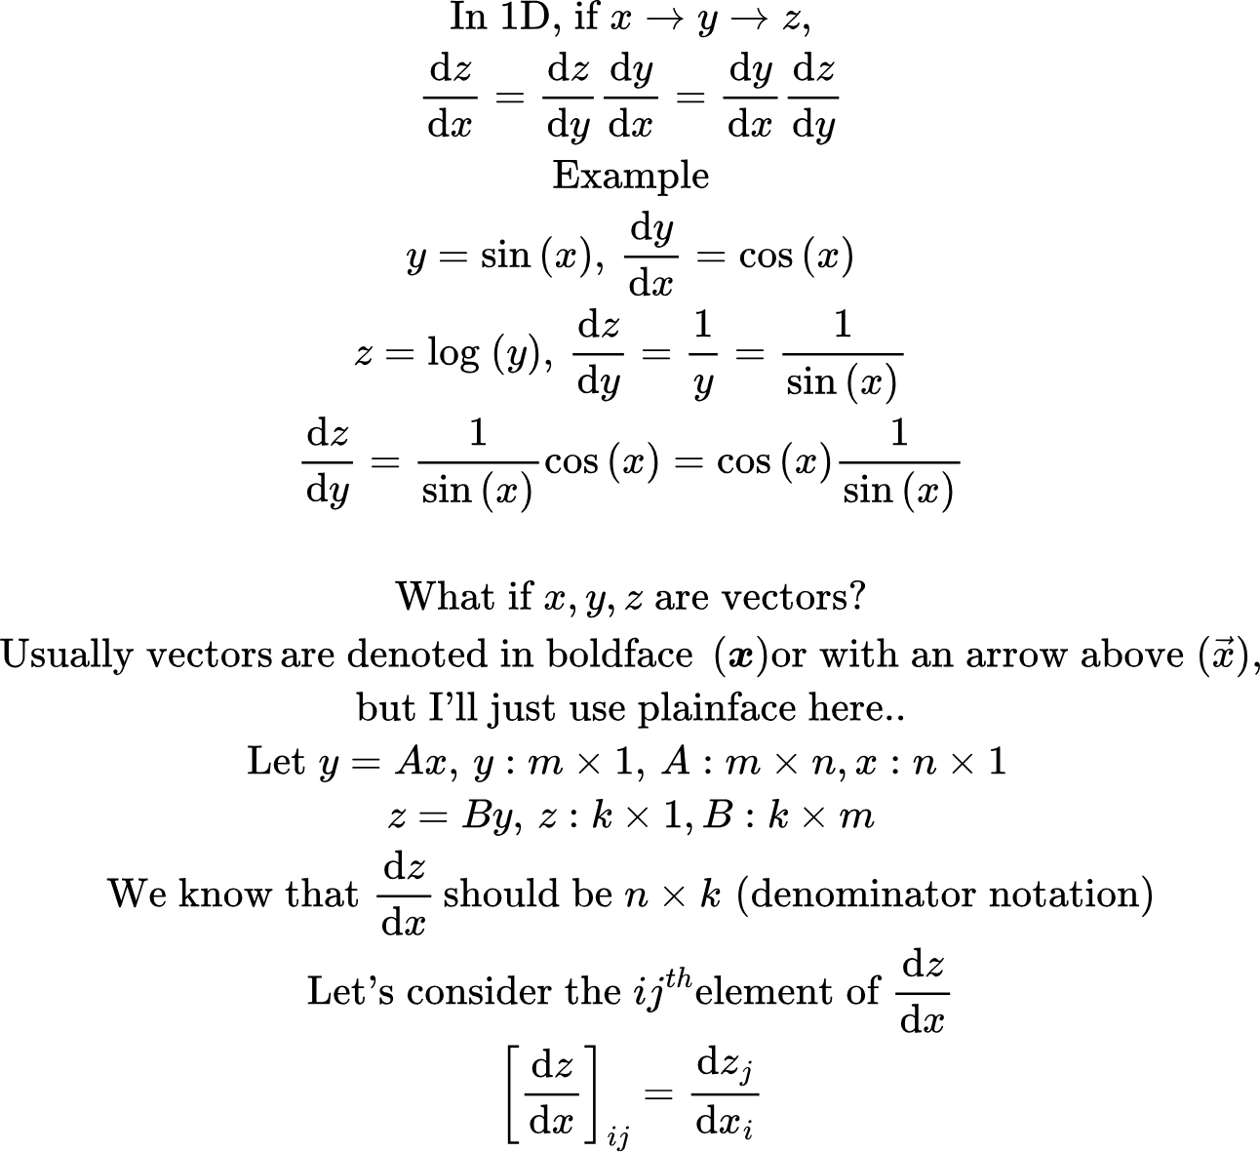
Chain Rule
verify_derivatives.py

Slide 8
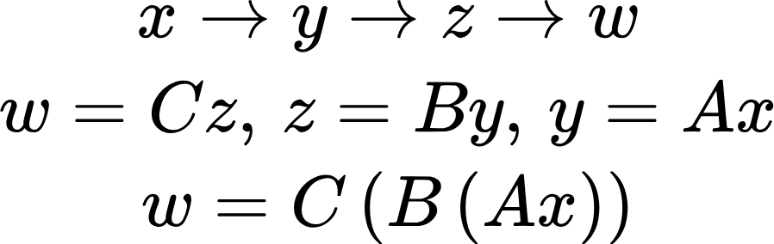
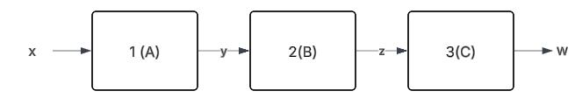
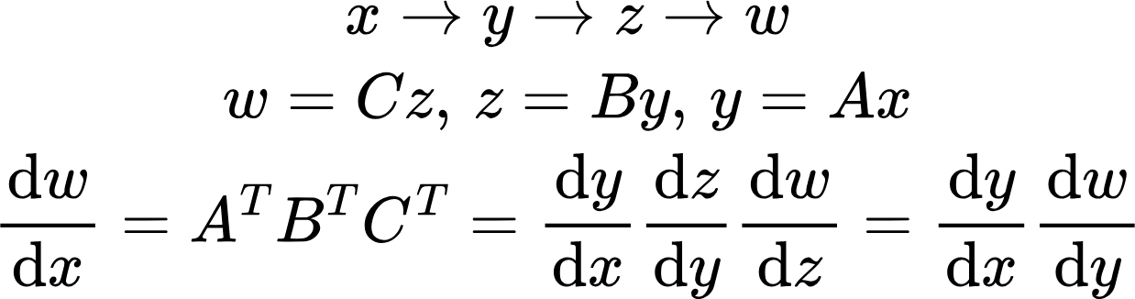
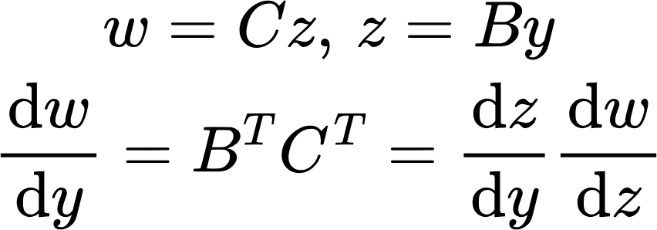
Chain Rule
Output of layer 1
Output of layer 2
Derivative of network output wrt input to layer 1
Derivative of network output wrt layer 1 output.. Layer 1 doesn’t care how many layers are ahead of it!
Derivative of layer 1 output wrt input
Derivative of network output wrt layer 2 output.. Layer 1 doesn’t care how many layers are ahead of it!
Derivative of network output wrt input to layer 2
Derivative of layer 2 output wrt input

Slide 9
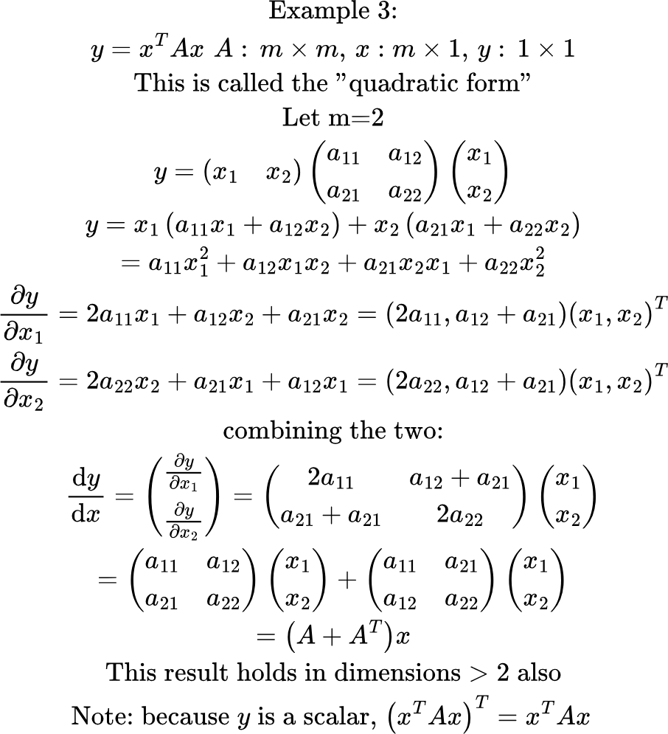
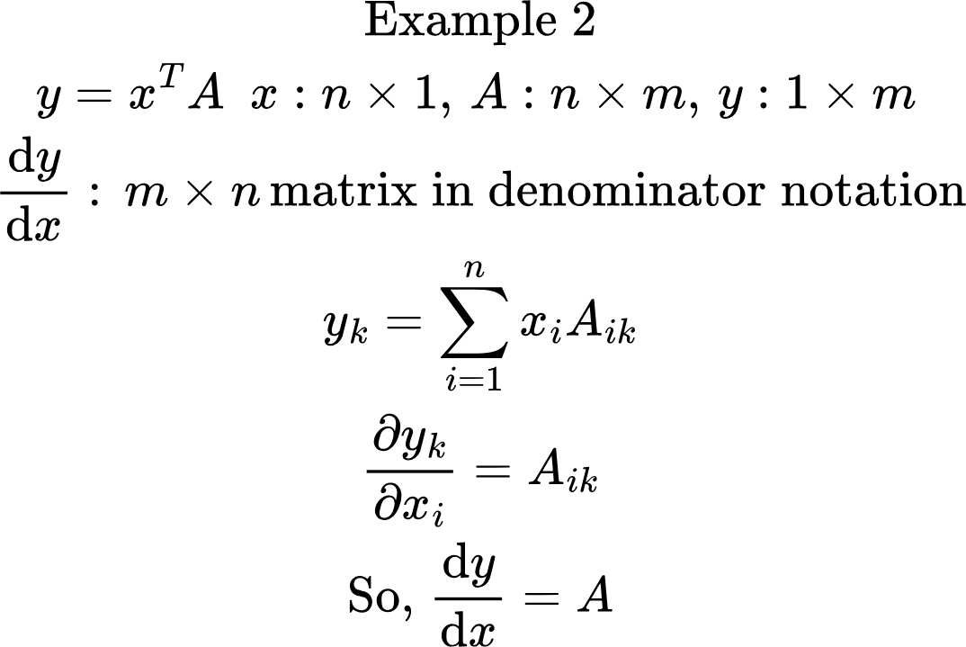
Some more Examples..

Slide 10
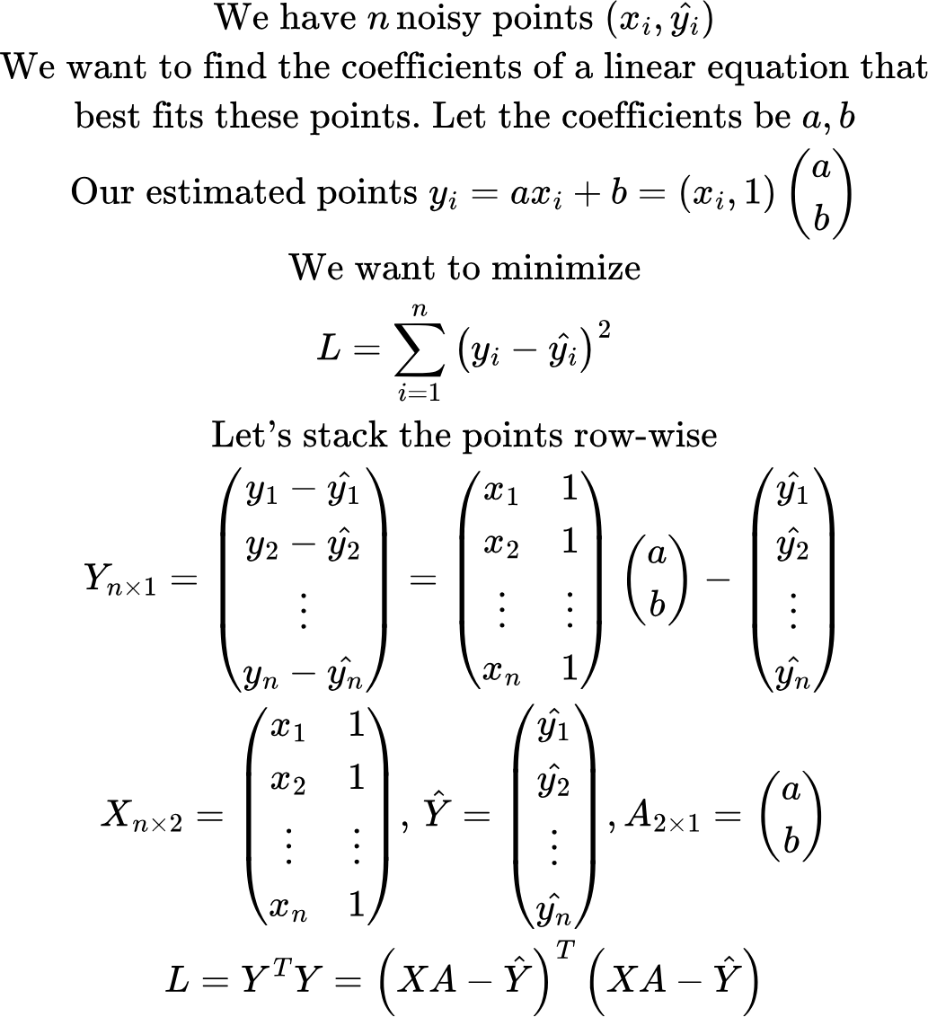
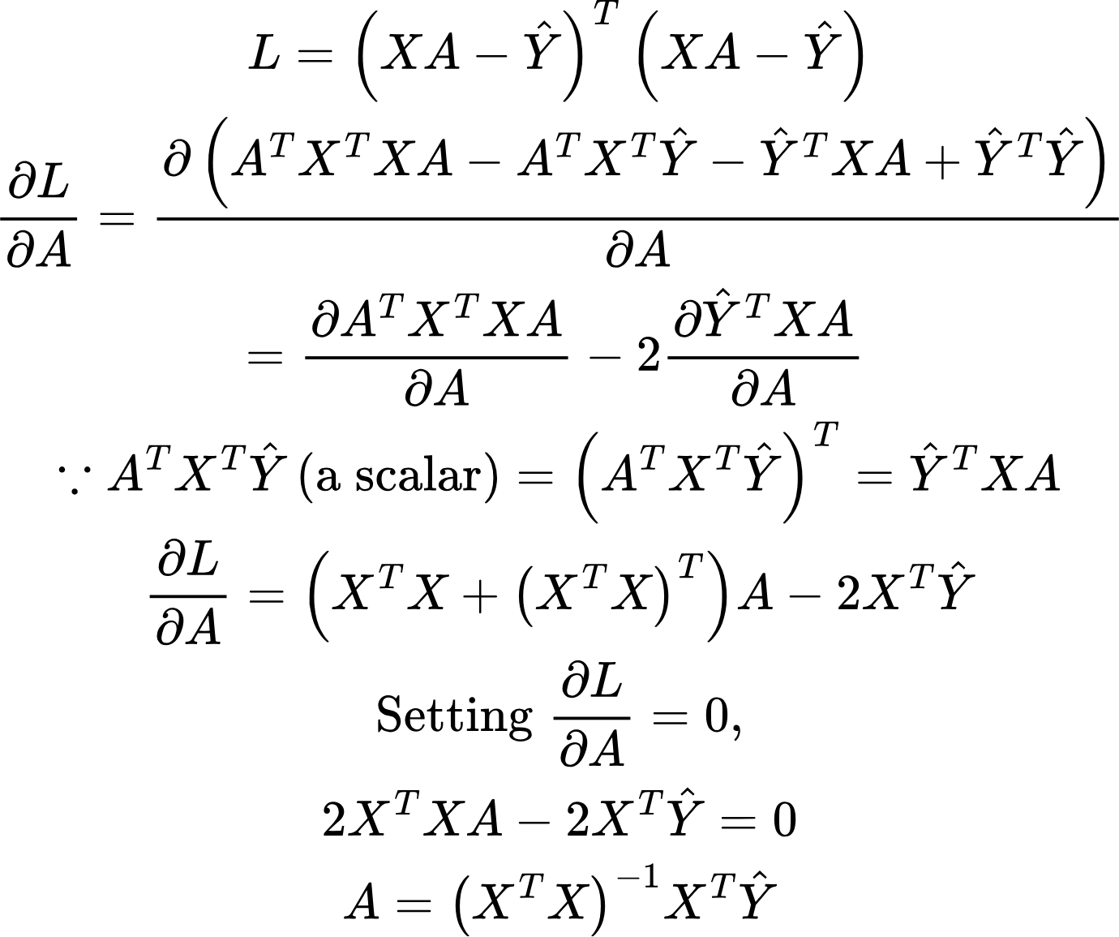
Using this math to simplify linear regression..
Code: linear_regression.py in code for lecture 1.3

Slide 11
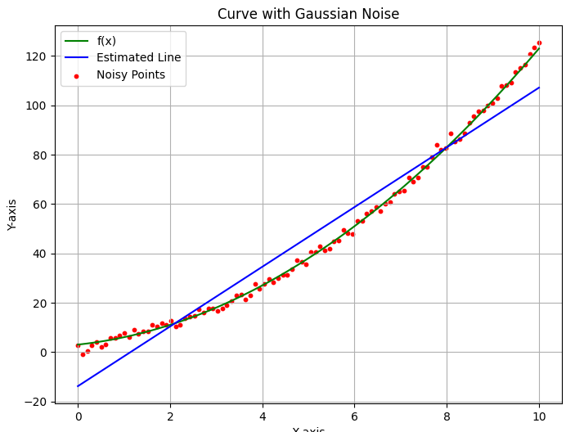
Limits of linear regression..
Trying to fit a linear function to points around a quadratic function will naturally result in higher errors..

Slide 12
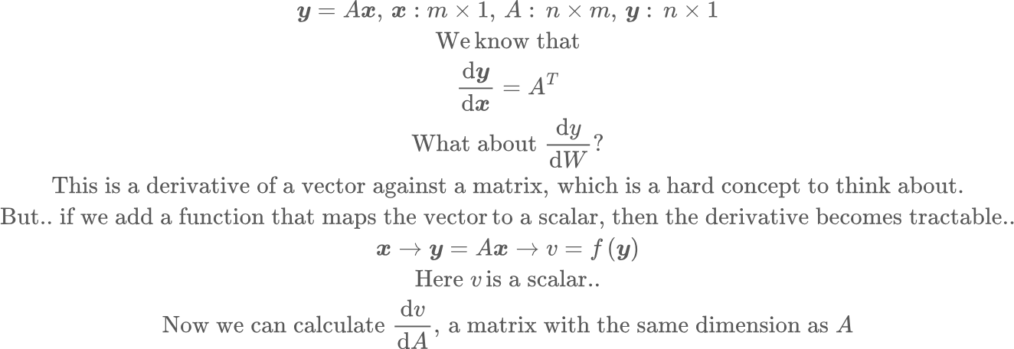
Derivative of a vector against a matrix

Slide 13
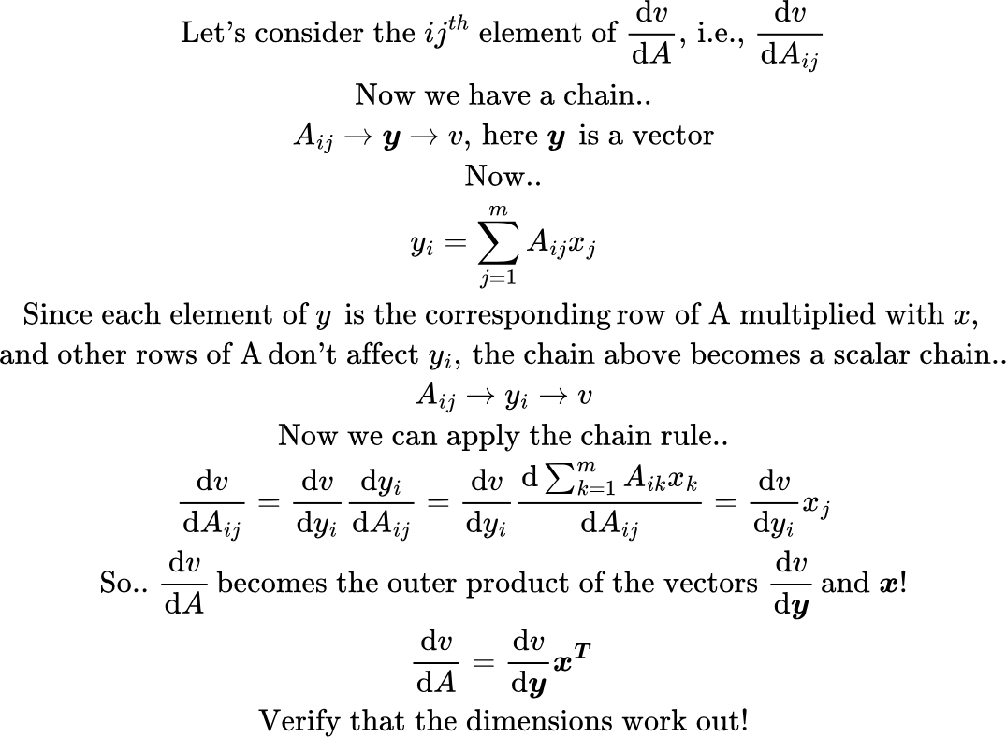
Derivative of a vector against a matrix

Slide 14
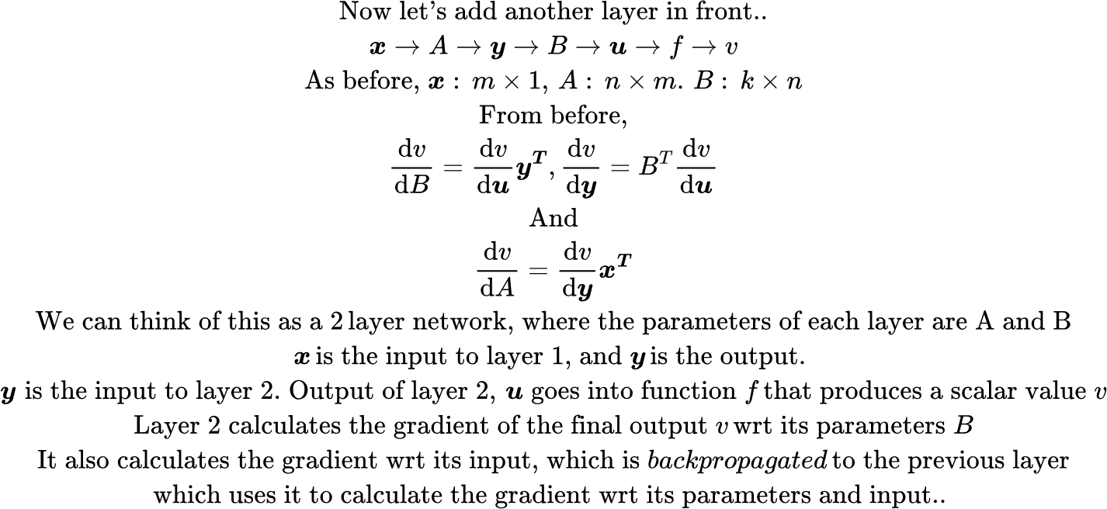
Derivative of a vector against a matrix
Code: 2_layer_network_derivatives.py

Slide 15
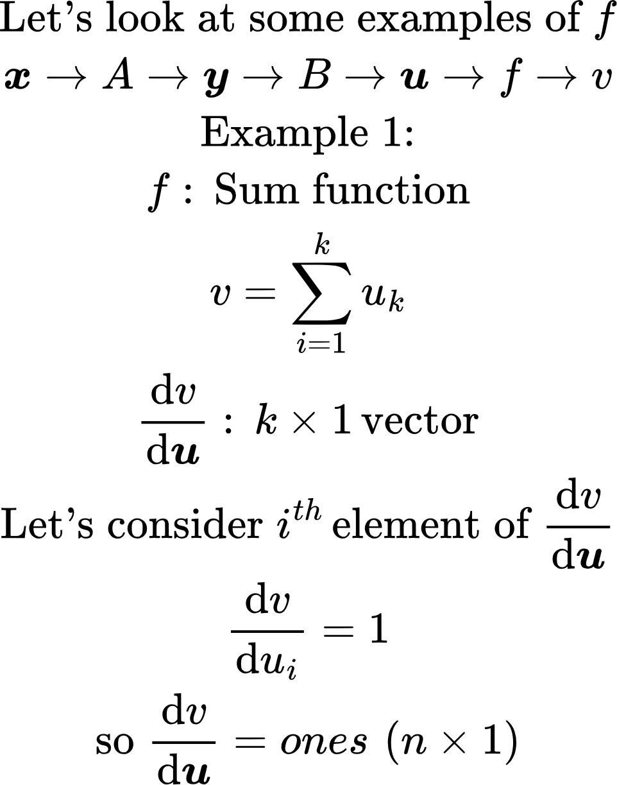
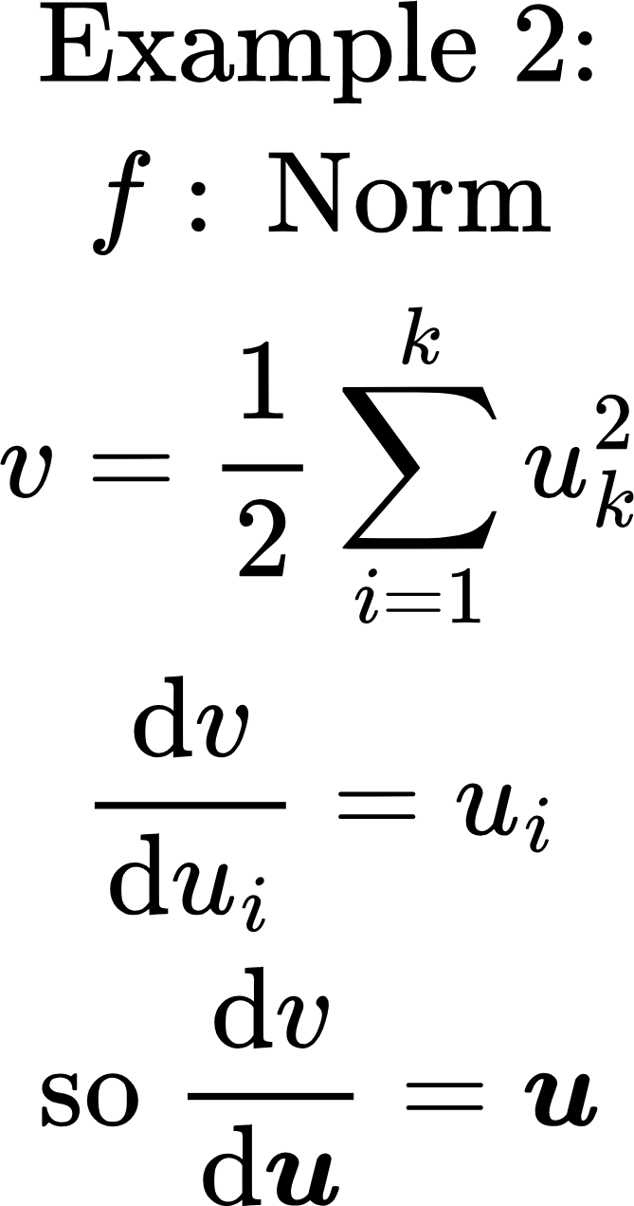
Examples of f
Code: 2_layer_network_optimization.py

Slide 16
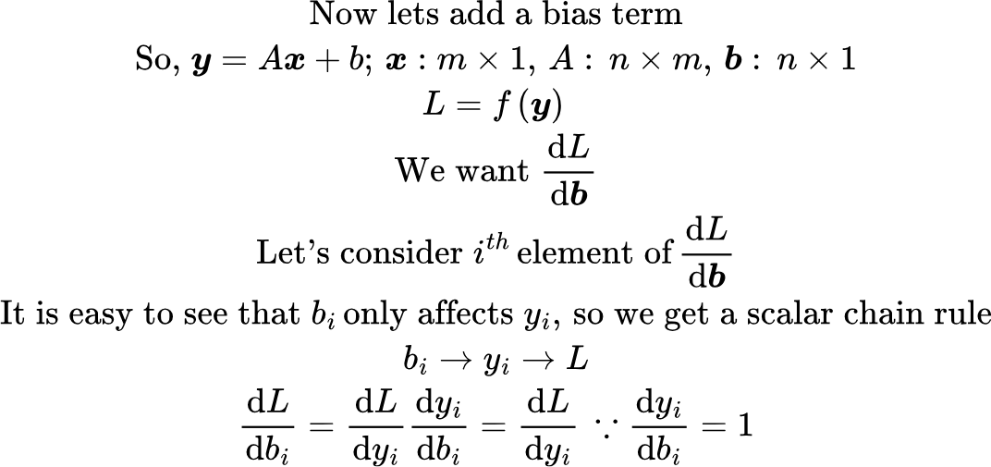
Adding a bias
A
y
f
x
L
b

Slide 17
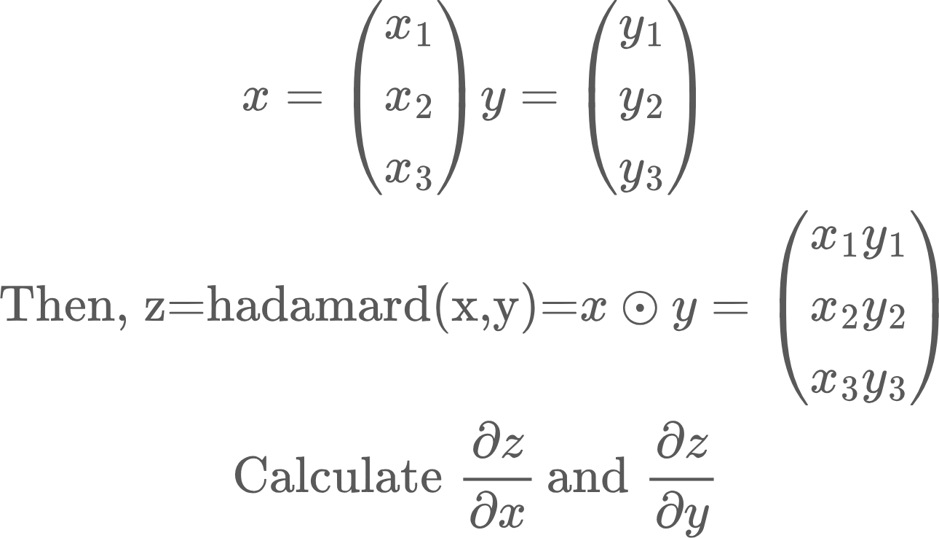
Homework problems
Hadamard product of two vectors is defined as the element-wise product. Eg.,
For some reason, we want the intercept b to remain small. How would add this constraint to the regression problem? Solve for optimal values of a and b with this constraint
.

Slide 18

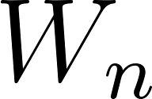

Recall: Structure of a Network
Forward Pass or Inference
labels
ReLU
Loss function
Error
…
Backward pass or training
Points on a 2D space
Sequence of embeddings
Fourier transform coefficients of an audio sample
Images
Image patches
Video frames..
Key question: How do I adjust the weights to reduce error?
Answer: Backpropagation!

